Slide 1
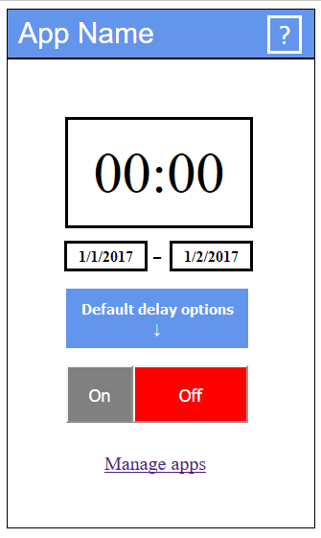
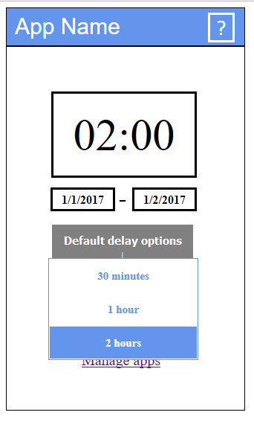
Notification Management

Slide 2
Group members
Markus Heino
Mohammed Alanny
Seppo Pakonen
Jaakko Ikäheimo

Slide 3
Quick Overview
Android application using AWARE framework
Notifications shall be delayed up to an user indicated time
Delaying notifications is a desired feature

Slide 4
The purpose of the project
We want to push to our limits as a group and as individuals
We want to offer something that helps everyone in their everyday life
We offer a chance to ease your stress

Slide 5
State of the art
Notifications are a source of disruptions
Recovering from distractions is costly
Good opportunities to push notifications have been studied.
General notification processing have been available only since 2013 in Android and iPhone
Many patents covers already notification managers

Slide 6
Design process
We started by dividing the group in half (background team and interface team)
Interface team been focusing on illustration of menus
Background team have focused on system desing
We have been cathering feedback during the project by passing example early phase mockups for potential users
It have been a iterative process

Slide 7
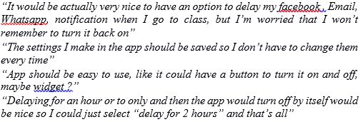
User comments
These are some of the user comments that had effect on our implementation on design.
As an example the extra button for fast delay for spesific time like 2hours, was added to interface based on the user feedback.
All user feedback have been taken into considiration, no matter have the feedback been negative or positive. This way we have been able to make sure, that what we offer is strictly based on user feedback and our research.

Slide 8
Scenario
Mika is having an important meeting, he don’t want to turn off his phone because wife might call since she is pregnant. But in the other hand he don’t want anyone else to disturb him during the meeting. He have agreed together with wife that she will contact only with a whatsapp message.
This is the part where we come aboard. We offer Mika an app that gives him a opportunity to delay all notification during the meeting and only pass those that comes through whatsapp

Slide 9
Use cases & Requirements
Instantly delaying notifications with a one button
Instantly stopping delaying notifications
All should be able to done by the user indicated time
Interface includes modifying times and days
Feedback anonymous
App available in play-store (compliance with Google Play-store term of service

Slide 10
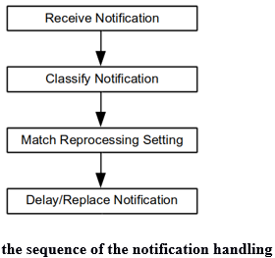
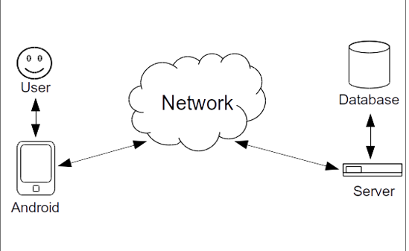
System design

Slide 11
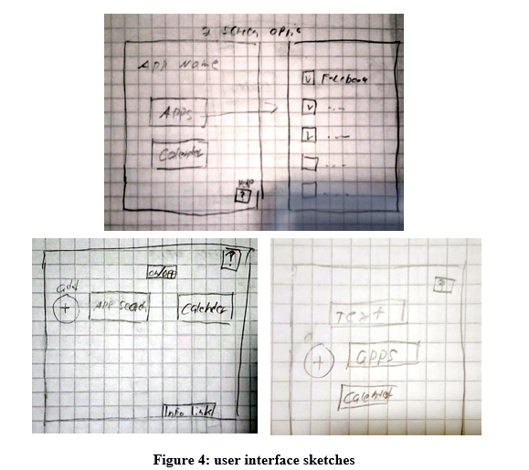
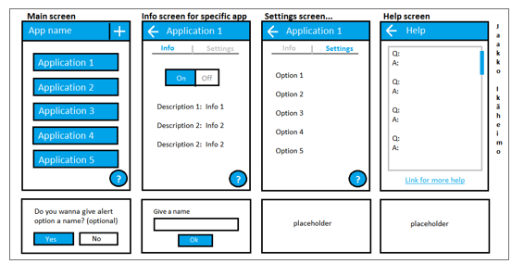
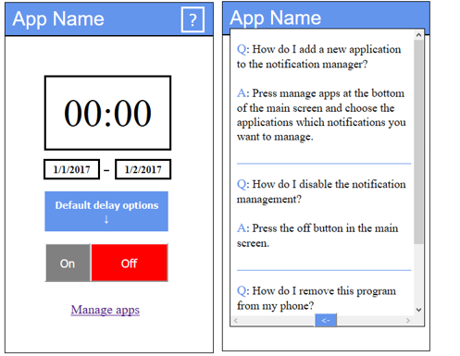
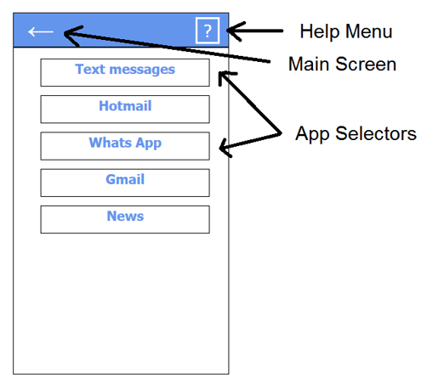
Interface design
Drafts at the beginning
← Late phase drafts →

Slide 12
Evaluation
Evaluation was done after every step either inside the group or by extending to show prototypes to potential customers
All the feedback was gathered from friends and family that could be potential users
Feedback have been more than helpful and have had a lot impact on our interface
Changes been made for the whole project regarding feedback from potential users and our own thoughts

Slide 13
Analysis
The annoyance of push notifications is scientifically known subject
Similar applications exists in the Play-store
We want to offer an app for everyday use
We want to focus on keeping the app as simple as it can be.
Easy and fast to use

Slide 14
Next steps
More research
Implemention for the app by following our design
Setting deadlines for early prototypes
Setting timetables
Testing during the whole project

